Slide 1

SOMMELIER
SCIENCERS
May 30, 2023

Slide 2
PRESENTERS
Alexia Lewis Oliver Taylor
Exploration/Clustering
Classification/Regression

Slide 3

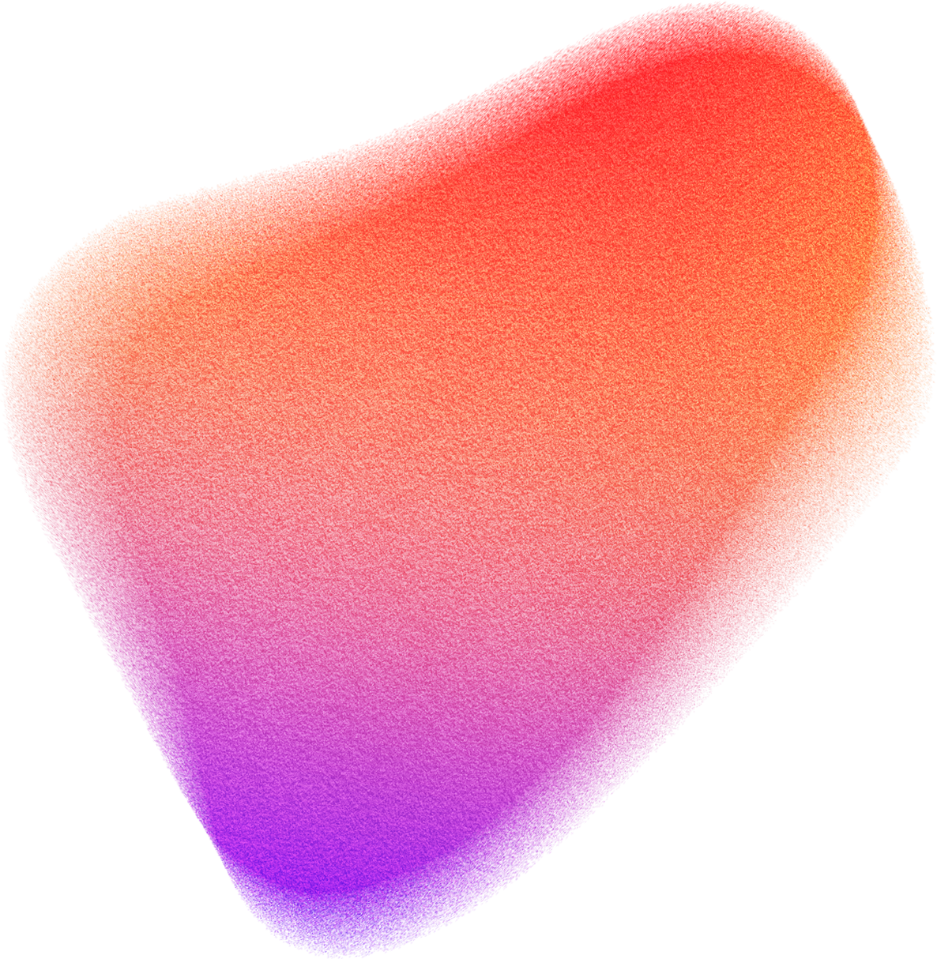
AGENDA
Executive Summary
Findings
Recommendations
Conclusion

Slide 4

EXECUTIVE SUMMARY
Big Idea
Top Findings
Goal
Using ML techniques we can take the chemicals of wine and predict the finished wine's quality similar to a sommelier
Acidity, sodium, and alcohol levels affect quality
Quality Rating is 3-9
Predict the Quality of Vinho Verde Wine
Future Researchers: Gather data on more grape types.
Data Engineers: Either split the dataset into white and red and create separate models or gather more data on red types of vinho verde to balance the dataframe and provide additional insights.
Data Scientists: Remove outliers and engineer "acid" and "feel" features using appropriate columns.
Business: We do not recommend putting the regression models into production.
Recommendation
Notes:
Moving into the Executive Summary

Slide 5
EXECUTIVE SUMMARY
Big Idea
Top Findings
Goal
Using ML techniques we can take the chemicals of wine and predict the finished wine's quality similar to a sommelier
Acidity, sodium, and alcohol levels affect quality
Quality Rating is 3-9
Predict the Quality of Vinho Verde Wine
Future Researchers: Gather data on more grape types.
Data Engineers: Either split the dataset into white and red and create separate models or gather more data on red types of vinho verde to balance the dataframe and provide additional insights.
Data Scientists: Remove outliers and engineer "acid" and "feel" features using appropriate columns.
Business: We do not recommend putting the regression models into production.
Recommendation
Notes:
We have the big idea which states that
By using both clustering and classification modeling we can take the raw chemical makeup of wine and generate wine quality predictions similar to that of a trained sommelier.

Slide 6
EXECUTIVE SUMMARY
Big Idea
Top Findings
Goal
Using ML techniques we can take the chemicals of wine and predict the finished wine's quality similar to a sommelier
Acidity, sodium, and alcohol levels affect quality
Quality Rating is 3-9
Predict the Quality of Vinho Verde Wine
Future Researchers: Gather data on more grape types.
Data Engineers: Either split the dataset into white and red and create separate models or gather more data on red types of vinho verde to balance the dataframe and provide additional insights.
Data Scientists: Remove outliers and engineer "acid" and "feel" features using appropriate columns.
Business: We do not recommend putting the regression models into production.
Recommendation
Notes:
Our top findings were that acidity, sodium and alcohol levels affect the quality of wine.
We also found that the rating scale is actually 3 through 9, not 0 through 10.

Slide 7
EXECUTIVE SUMMARY
Big Idea
Top Findings
Goal
Using ML techniques we can take the chemicals of wine and predict the finished wine's quality similar to a sommelier
Acidity, sodium, and alcohol levels affect quality
Quality Rating is 3-9
Predict the Quality of Vinho Verde Wine
Future Researchers: Gather data on more grape types.
Data Engineers: Either split the dataset into white and red and create separate models or gather more data on red types of vinho verde to balance the dataframe and provide additional insights.
Data Scientists: Remove outliers and engineer "acid" and "feel" features using appropriate columns.
Business: We do not recommend putting the regression models into production.
Recommendation
Notes:
The goal of this project is to predict the quality of wine.

Slide 8
EXECUTIVE SUMMARY
Big Idea
Top Findings
Goal
Using ML techniques we can take the chemicals of wine and predict the finished wine's quality similar to a sommelier
Acidity, sodium, and alcohol levels affect quality
Quality Rating is 3-9
Predict the Quality of Vinho Verde Wine
Future Researchers: Gather data on more grape types.
Data Engineers: Either split the dataset into white and red and create separate models or gather more data. on red types of vinho verde to balance the dataframe and provide additional insights.
Data Scientists: Remove outliers and engineer "acid" and "feel" features using appropriate columns.
Business: We do not recommend putting the regression models into production.
Recommendation
Notes:
Recommendations we can dive deeper into later but for now, we need more data and we don't recommend business action at this time.

Slide 9
EXPLORATION FINDINGS
Acidity, sodium, and alcohol affect quality
White wine results in a much wider range of residual sugars
Type has a 75/25 percent proportion
White = 75%
Red = 25%
pH typical range 0-14
wine range 2.7 - 4
Quality Rating is 3-9
Notes:
During our exploration phase we uncovered that acidity, alcohol, and sodium levels affect the quality rating.
75% of the data is for white wine and 25% is for red wine and the pH lies between 2.7 and 4.
For context, battery acid is a 1, vinegar is a 3, and tomato juice is a 4.

Slide 10
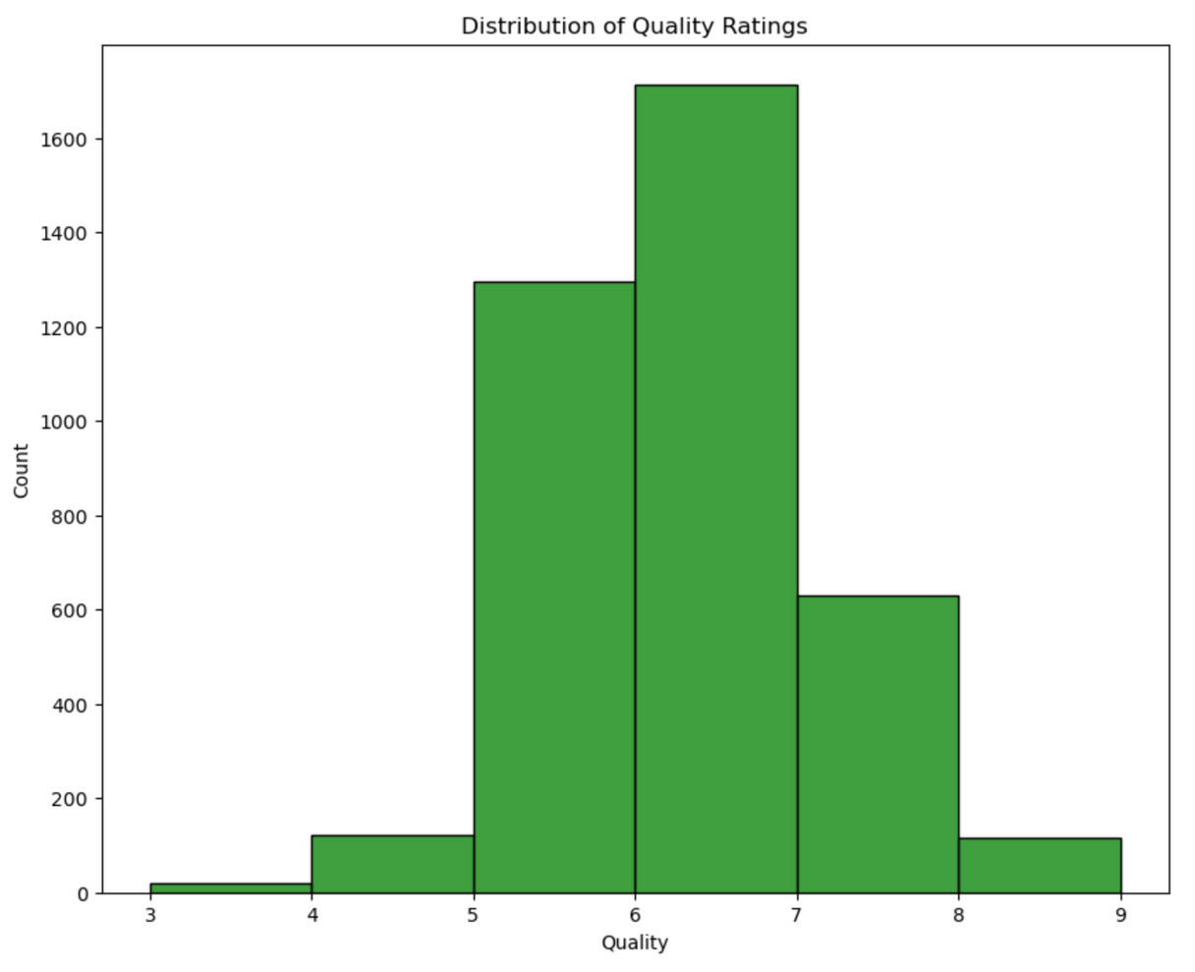
EXPLORATION FINDINGS
Notes:
We also discovered that the quality rating does not go from 0 to 10 like originally thought.

Slide 11
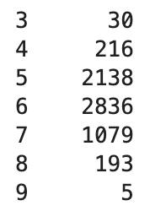
EXPLORATION FINDINGS
Notes:
The quality range is actually 3-9.
Wines with a quality of 3 have a count of 30 wines.
Those with a quality of 9 have a count of 5 wines.
The mean is 6

Slide 12
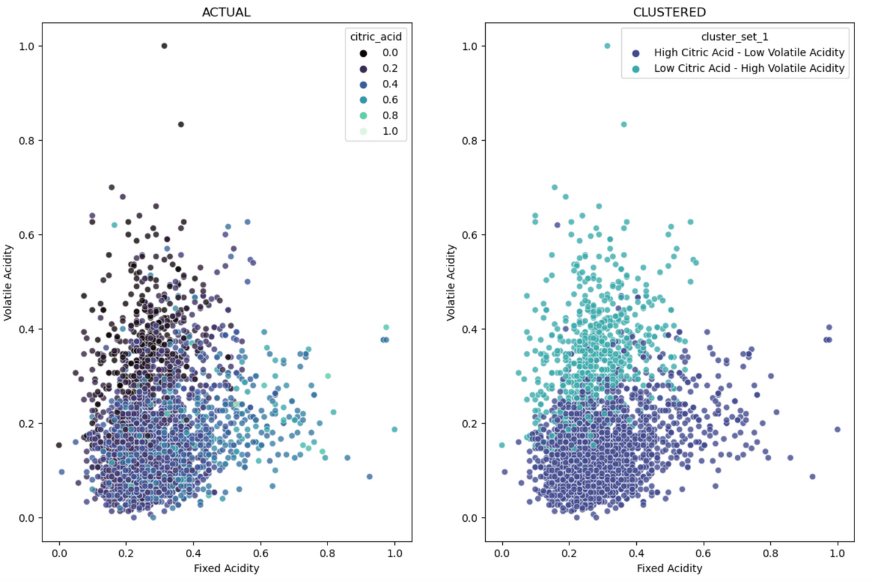
CLUSTERING FINDINGS
Notes:
We learned that volatile acidity results from the degradation of citric acid. This type of acidity can give wine a more vinegar-like flavor. Since these columns are related, we engineered a feature using clustering called "acid."
The graph on the left is the actual data and the graph on the right shows the clustered data. While there aren't any clear clusters, it did help identify the relationship between acid-related data.

Slide 13
CLUSTERING FINDINGS
Volatile acidity results from the degradation of citric acid
The actual relationship and the clustered relationship created the feature "Acid"
Notes:
The darker dots on the left indicate lower citric acid and higher volatile acidity, which checks against our domain knowledge that states volatile acid results from the degradation of citric acid.
These darker dots also correspond with the lighter dots on the right graph displaying the clustering results, indicating a relationship.
We used this engineered feature in our model.

Slide 14

MODELING KEY FINDINGS
Several classification and regression models were validated and the random forest classification model at a depth of 8 was the best performing model
The model beat the baseline of 44% with a accuracy score of 59%

Slide 15
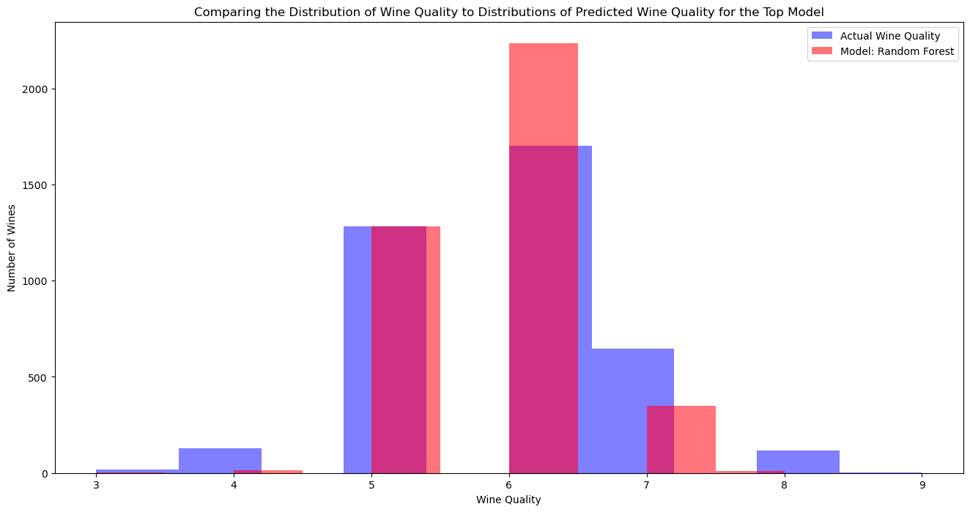
MODELING FINDINGS
Random forest Model with no clusters
Baseline: 44%
Test Accuracy: 59%
Test Precision:
3: 0%
4: 50%
5: 63%
6: 55%
7: 66%
8: 0%
9: 0%

Slide 16
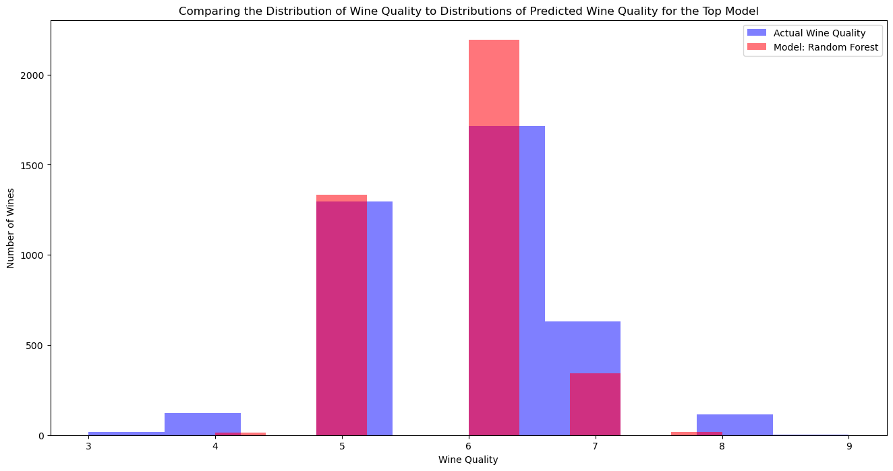
MODELING FINDINGS
Random Forest with clusters
Baseline: 44%
Test Accuracy: 59%
Test Precision:
3: 0%
4: 0%
5: 64%
6: 56%
7: 62%
8: 100%
9: 0%

Slide 17
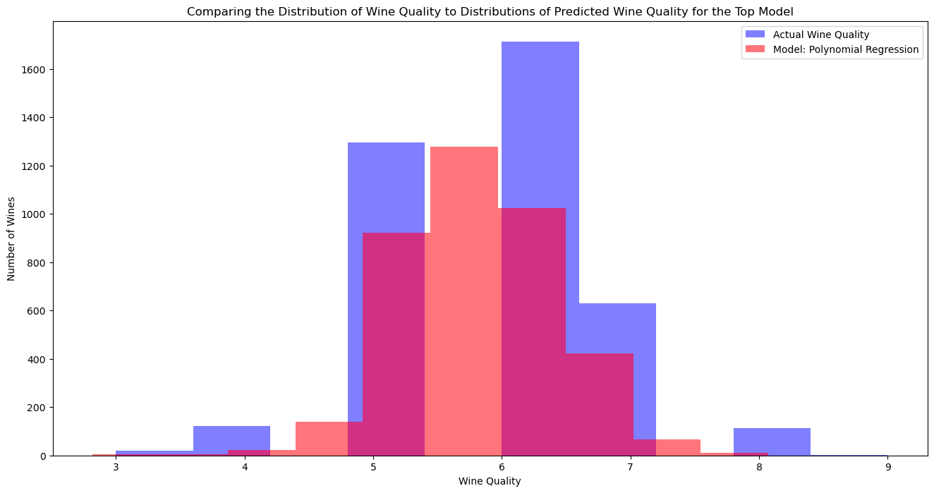
MODELING FINDINGS
Polynomial Model without clusters
Baseline RMSE: .87
Test RMSE: .72
Test: r^2: .31

Slide 18
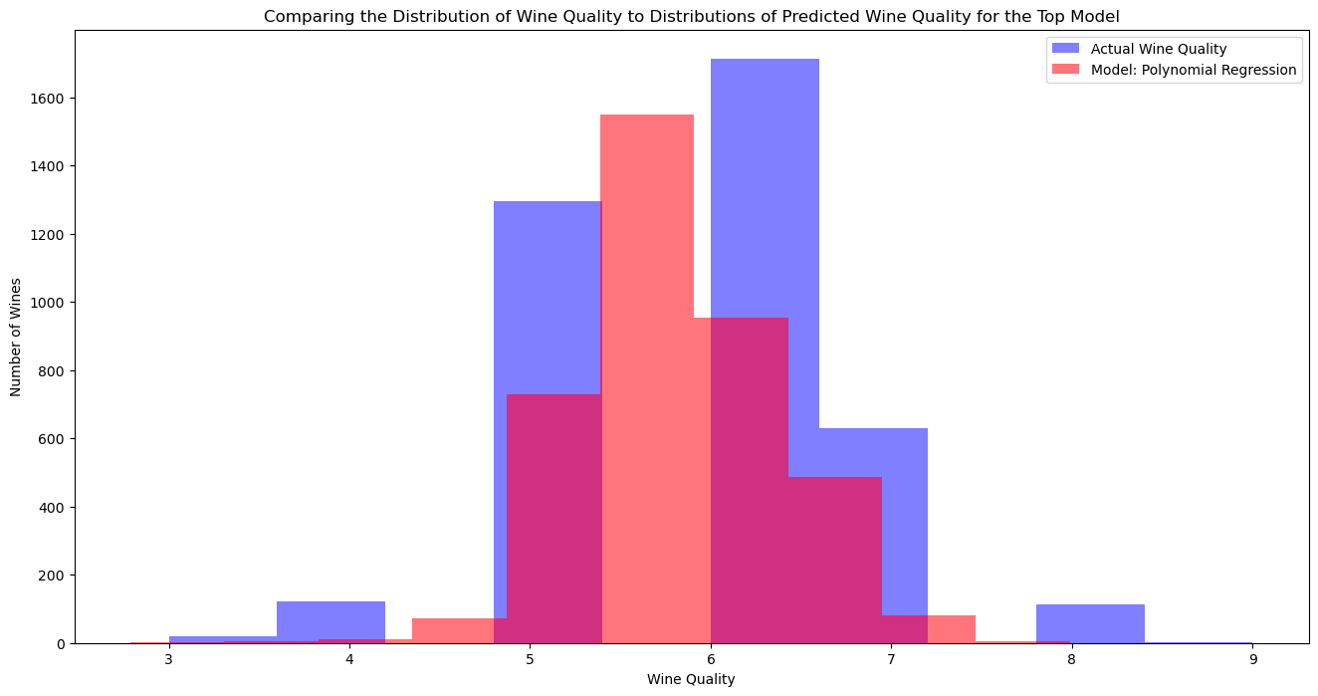
MODELING FINDINGS
Polynomial Model without clusters
Baseline RMSE: .87
Test RMSE: .72
Test r^2: .31

Slide 19
CONCLUSION
3 key drivers are acidity, sodium, and alcohol content
Clustering identified relationships which we feature-engineered and modeled. The feature from clustering (“acid") did not significantly affect the predictive modeling outcomes.
The classification model, random forest, produced the best results with decent precision numbers and an accuracy score of 59% beating the baseline of 44%.
Out of the regression models the polynomial model performed at an RMSE of .72.

Slide 20
KEY CONCLUSION TAKEAWAY
We CAN predict wine quality using cluster and predictive modeling and get outcomes similar to those of a sommelier.

Slide 21
RECOMMENDATIONS AND NEXT STEPS
Future Researchers: Gather data on more grape types.
Data Engineers: Either split the dataset into white and red and create separate models or gather more data on red types of vinho verde to balance the dataframe and provide additional insights.
Data Scientists: Remove outliers and engineer "acid" and "feel" features using appropriate columns.
Business: The models succeed as a proof of concept but we do not recommend putting these models into production at this time. With further research more accurate models could be made.

Slide 22
THE END
FOR SOMMELIERS
The age of the robot sommelier is upon us.

